Slide 1
SRAM Write Assist Circuit Using Cell Supply Voltage Self-Collapse With Bitline Charge Sharing for Near-Threshold Operation
April 20, 2023
IMT2020507 - Asmita Zjigyasu
MT2022507 - Kavya Agarwal
MT2022516 - Ritesh Lalwani
MT2022524 - Aditya Singh

Slide 2
CONTENTS
OBJECTIVE
INTRODUCTION
MOTIVATION
PREVIOUS WORKS
PROPOSED WORK
SIMULATION RESULTS AND COMPARISIONS
CONCLUSION
FUTURE WORK
REFERENCES

Slide 3
OBJECTIVE
Design a Write-Assist circuit using Cell VDD (CV_{DD}) self-collapse with Bitline (BL) charge sharing in the near threshold voltage (V_{TH}) region by utilising –
CV_{DD} self-collapse
Feedback operation by detecting a write failure

Slide 4
INTRODUCTION TO SRAM
Static random-access memory (static RAM or SRAM) is a type of random-access memory (RAM) that uses latching circuitry (flip-flop) to store each bit. SRAM will hold its data permanently in the presence of power, but data is lost as soon as power is removed.
SRAM is a popular choice for microcontrollers when fast and efficient operations with low power consumption are needed. In computer systems, it is commonly used as the primary working memory, including the internal registers and cache of a CPU.

Slide 5
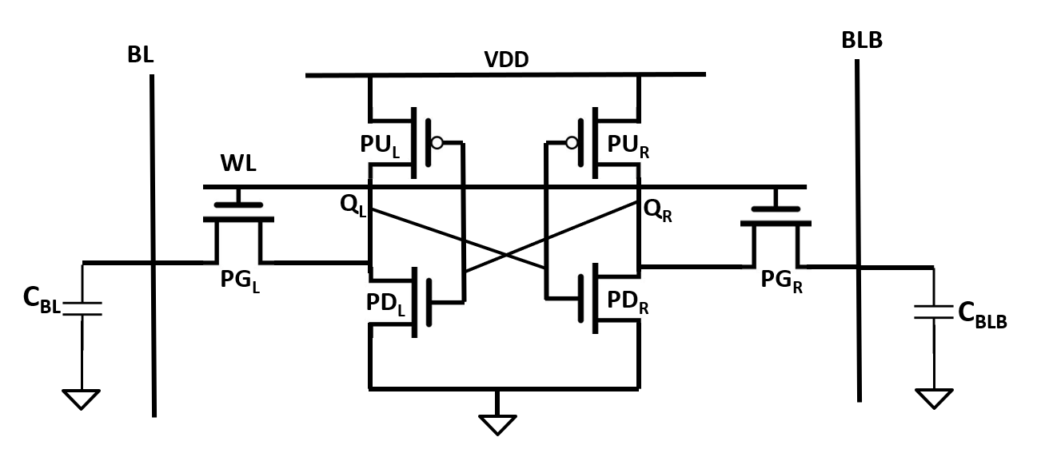
6T SRAM CELL – READ OPERATION
Pre charge BL and BLB to HIGH.
Turn on WL
BL or BLB pulled down to 0 based on Q_{L} and Q_{R}. So, for eg – if Q_{L}=0, Q_{R}=1, BL discharges via PG_{L} , PD_{L,} GND; and; BLB stays HIGH but Q_{L} bumps up slightly.
NOTE – In order to prevent Q from changing its value, strength of PD_{L} > PG_{L}, that is, ON resistance of PD_{L} < PG_{L}.

Slide 6
6T SRAM CELL – WRITE OPERATION
Drive BL and BLB to necessary values.
Turn on WL.
BL or BLB will drive Q_{L} and Q_{R} with new values. So, for eg – if Q_{L}=0, Q_{R}=1, BL =1 and BLB =0, This would force Q_{R} to low and Q_{R} to high.
NOTE – Strength of PGL > PUL, that is, ON resistance of PG_{L} < PU_{L}.
Hence strength of PD_{L} > PG_{L} > PU_{L}.

Slide 7
MOTIVATION
To achieve energy efficiency in System-on-Chip designs imperative for applications like wearables and bio-implant devices, lowering the supply voltage NEAR to the threshold voltage (V_{th}) is the most effective approach. However, this is limited by the minimum operating voltage (V_{MIN}) of the SRAM, which depends on the balance between its read-stability and write-ability as well as area constraints.
Some previous works utilising the CV_{DD} collapse, Negative bitline (NBL) concept and Gate modulated self-collapse (GSC) have been implemented but they do no offer significant improvements in energy efficiency.
This paper’s work aims to provide a design that would not only improve V_{MIN} but also use minimal write energy while doing so.

Slide 8
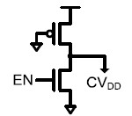
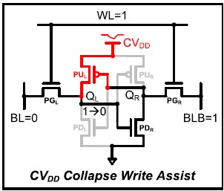
PREVIOUS WORKS 1 – SB-TVC
Write Assist Circuit - Strong-bias Transient CVDD Collapse
CV_{DD} lowered by voltage divider of nMOS and pMOS transistors.
DISADV - Consumes significant write energy. This is because of the large static current that would flow through the write assist circuit due to the pMOS being always ON and nMOS being ON due to Enable.

Slide 9
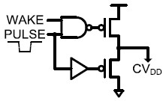
PREVIOUS WORKS 2 – PP-TVC
Write Assist Circuit - Pulsed-pMOS Transient CV_{DD} Collapse
pMOS pull-down transistor lowers the CV_{DD} instantaneously by using the PULSE signal.
DISADV - Write energy of PP-TVC is large because CV_{DD} in all selected columns should be lowered to the voltage level that ensures the write-ability of the worst SRAM cell. Generation of accurate pulse signal also consumes energy.

Slide 10
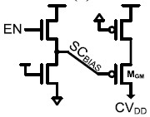
PREVIOUS WORKS 3 – GSC
Write Assist Circuit - Gate-modulated Self-collapse
CVDD is lowered by the write contention current that would come in PUL and PGL in the write assist circuit.
CVDD collapse ∝ 1/Write ability, hence for a cell with high write ability, energy used to collapse CVDD (write energy) is reduced.
But CV_{DD} collapse speed is low as the contention current would flow through the min. sized PU_{L} Transistor.
CV_{DD} collapse level would also depend on strength of M_{GM} transistor controlled by the SC_{BIAS} signal. DISADV – as SC_{BIAS} increases, M_{GM} weakens, CV_{DD} collapse level would decrease, but write energy to generate large SC_{BIAS} would increase due to static current in the 2 nMOS transistors.

Slide 11
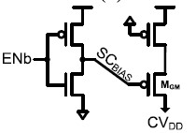
PREVIOUS WORKS 4 – SC
Write Assist Circuit - Self-collapse
M_{GM} is completely turned off and SC_{BIAS} is driven to V_{DD}.
No static current.
CV_{DD} collapse level not determined by strength of M_{GM} transistor.

Slide 12
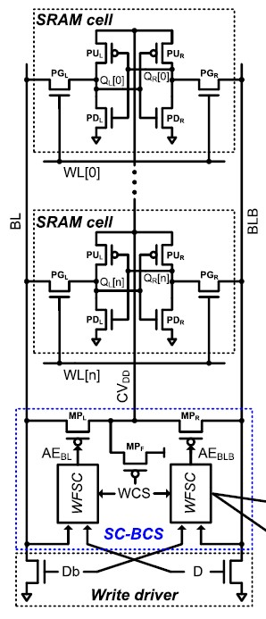
PROPOSED WORK – SC-BCS
Cell Supply Voltage Self-collapse With Bitline Charge Sharing
The proposed SC-BCS consists of a transistor to disconnect CV_{DD} from V_{DD} (MP_{F}), transistors for the charge sharing between CV_{DD} and BL or BLB (MP_{L} and MP_{R}, respectively), and a write fail sensing circuit (WFSC) to detect the write failure.
There are two phases of Operation. In the write-0 (or write-1) operation, the write driver drives BL (or BLB) to GND and WL is enabled.

Slide 13
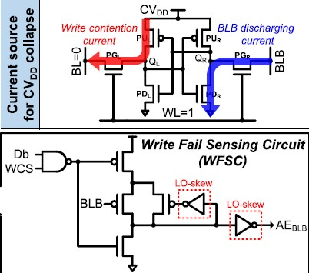
PROPOSED WORK – COMPLETE CIRCUIT

Slide 14
PROPOSED WORK – SC-BCS (Phase 1)
Cell Supply Voltage Self-collapse With Bitline Charge Sharing
Phase I (P1):
During P1, CV_{DD} is lowered by the write contention current of the selected cell and thus the write-ability is gradually improved.
Most SRAM cells are successfully written in P1.
In the case of the high-σ cell (SRAM cell with a low write-ability), the write operation fails.

Slide 15
PROPOSED WORK – SC-BCS (Phase 2)
Cell Supply Voltage Self-collapse With Bitline Charge Sharing
Phase II (P2):
As the storage nodes are not flipped, a pre-charged BLB (or BL) decreases by the discharging current flowing through the PG_{R} (or PG_{L}) and PDR (or PD_{L}) transistors in the high-σ cell during P1.
P2 starts when WFSC detects the write failure through the discharged BLB (or BL).
WFSC turns on MP_{R} (or MP_{L}), which performs charge sharing between CV_{DD} and BLB (or BL).
CVDD is lowered more by the discharged BLB (or BL) and the write-ability is improved.

Slide 16
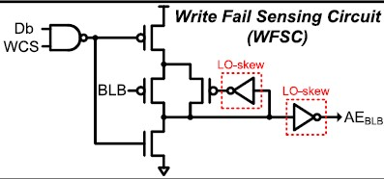
PROPOSED WORK – WFSC
Write Fail Sensing circuit
A key component to perform the feedback process in SC-BCS.
In the write-0 operation, the data(bar) signal D(Db) is GND (V_{DD}) and the write column select signal (WCS) is enabled to V_{DD}.
In the write-1 operational path, Pre discharged node floats and evaluation mode starts.
In the case of the high-σ cell, as BLB is discharged, the pMOS transistor is gradually turned on, and the voltage of the pre-discharged node starts to increase.
The LOW-skew inverters are applied to speed up the sensing of the pre-discharged node.

Slide 17
PROPOSED WORK – Advantages
Improves the write-ability with a smaller delay overhead than GSC and SC in the near-Vth region. This is because CV_{DD} can be lowered much faster by the two-phase operation of the proposed SC-BCS, which is achieved by utilizing not only the write contention current on the write-0 path but also the discharging current on the write-1 path.
While GSC and SC use both nMOS and pMOS transistors for the write driver and write MUX, the proposed SC-BCS uses only the nMOS transistor. This is because GSC and SC should prevent BL or BLB on the write-1 path from being discharged through the SRAM cell during the self-collapse, whereas the proposed SC-BCS detects the write fail and lowers CV_{DD} by utilizing the discharged BL or BLB on the write-1 path.
The proposed SC-BCS can reduce the energy consumed on the write-1 path. The write driver in GSC and SC drives BL or BLB on the write-1 path to V_{DD} and thus the static current flows through the SRAM cell until the stored data is flipped. However, because the proposed SC-BCS has a faster CV_{DD} collapse time than GSC and SC, the stored data is flipped much faster and the energy on the write-1 path is reduced.

Slide 18
SIMULATION RESULTS AND COMPARISIONS
Cadence Virtuoso circuit Schematics, Graphs and Comparison Tables

Slide 19
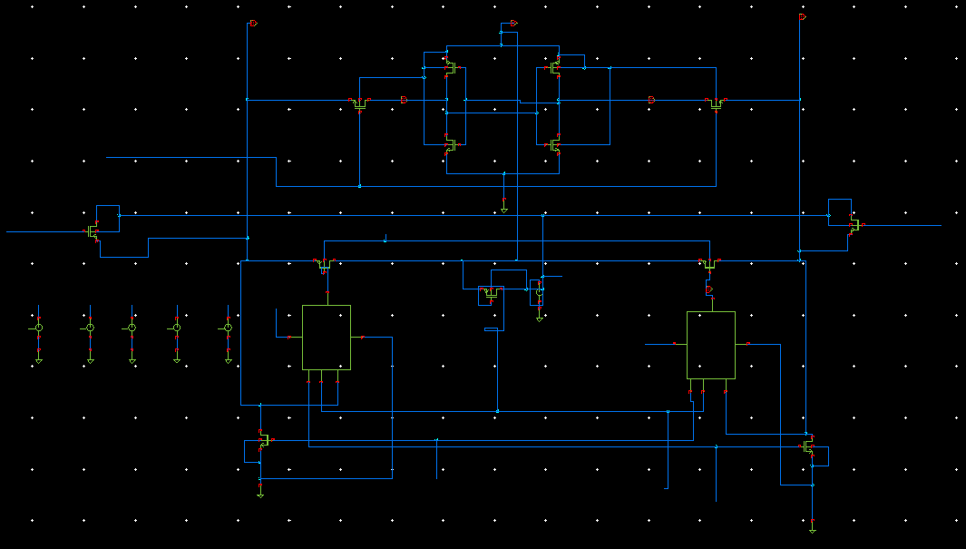
Schematic of SC-BCS SRAM cell

Slide 20
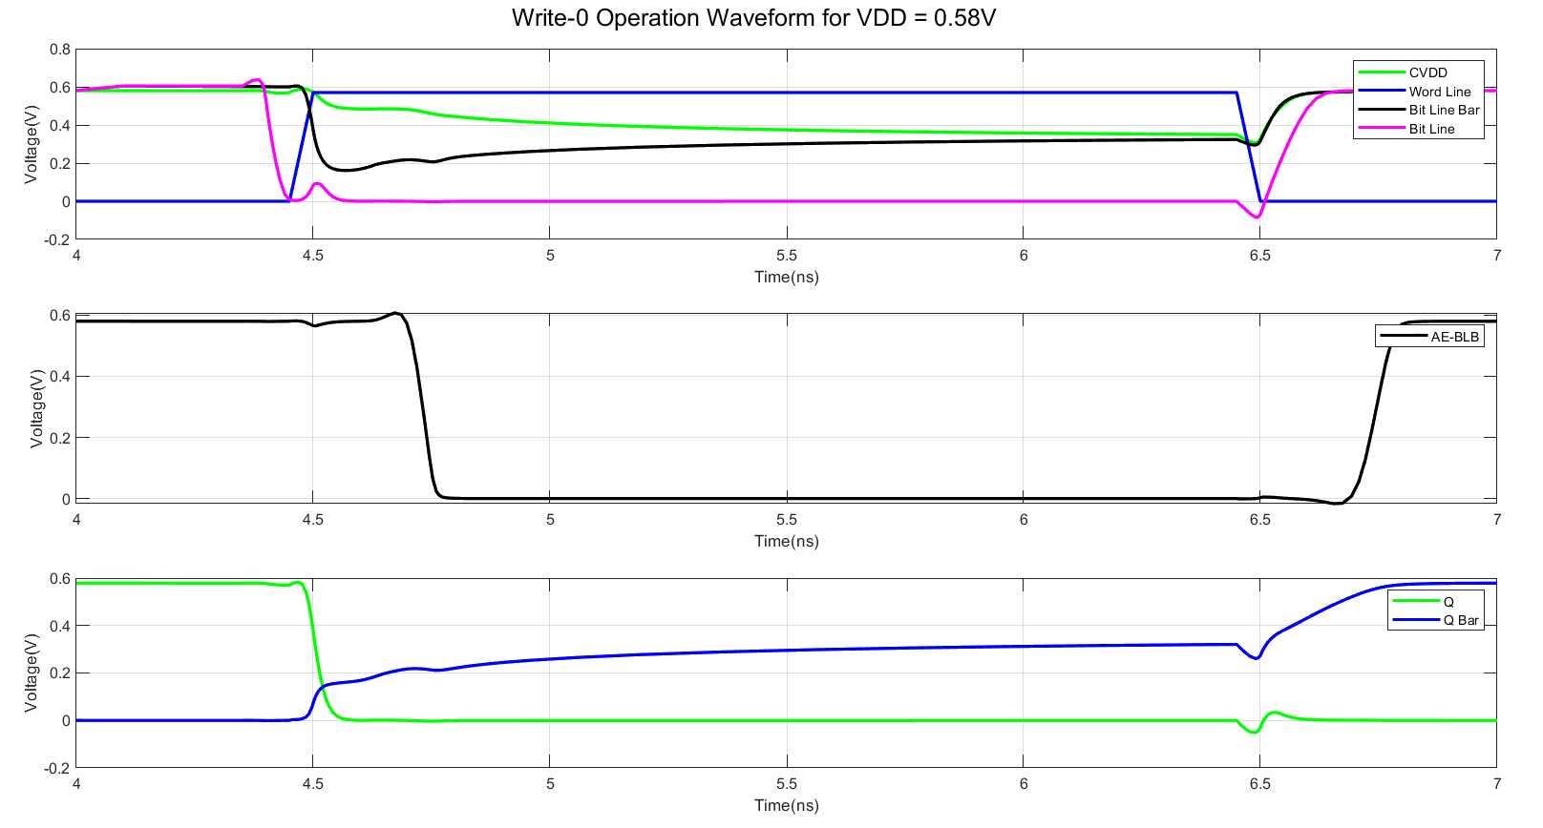
Write-0 Operation Waveform for HIGH-σ SC-BCS cell

Slide 21
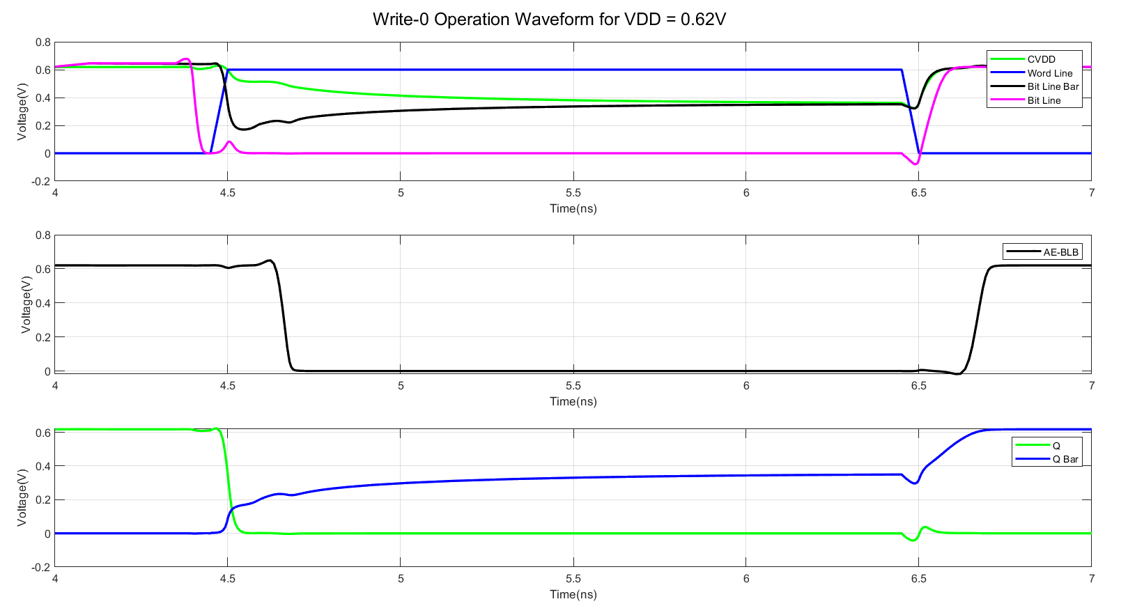
Write-0 Operation Waveform for HIGH-σ SC-BCS cell

Slide 22
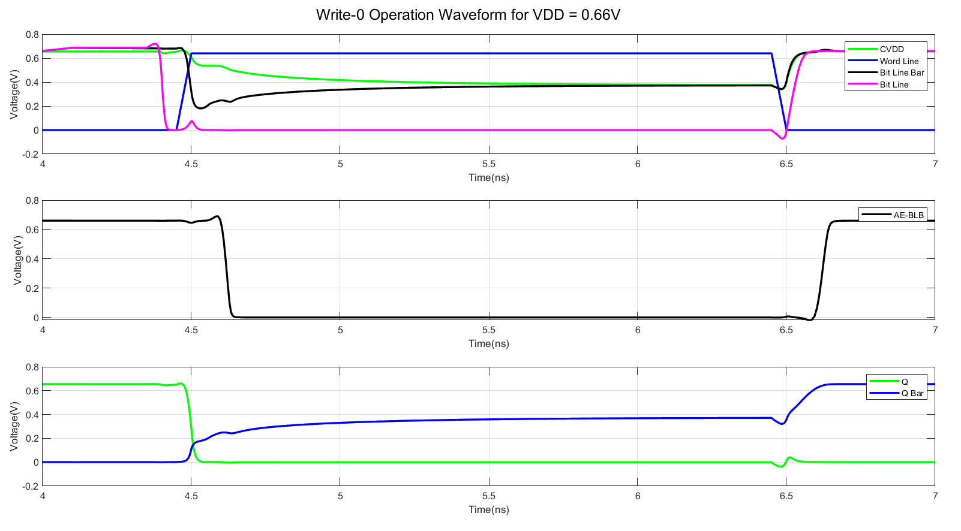
Write-0 Operation Waveform for HIGH-σ SC-BCS cell

Slide 23
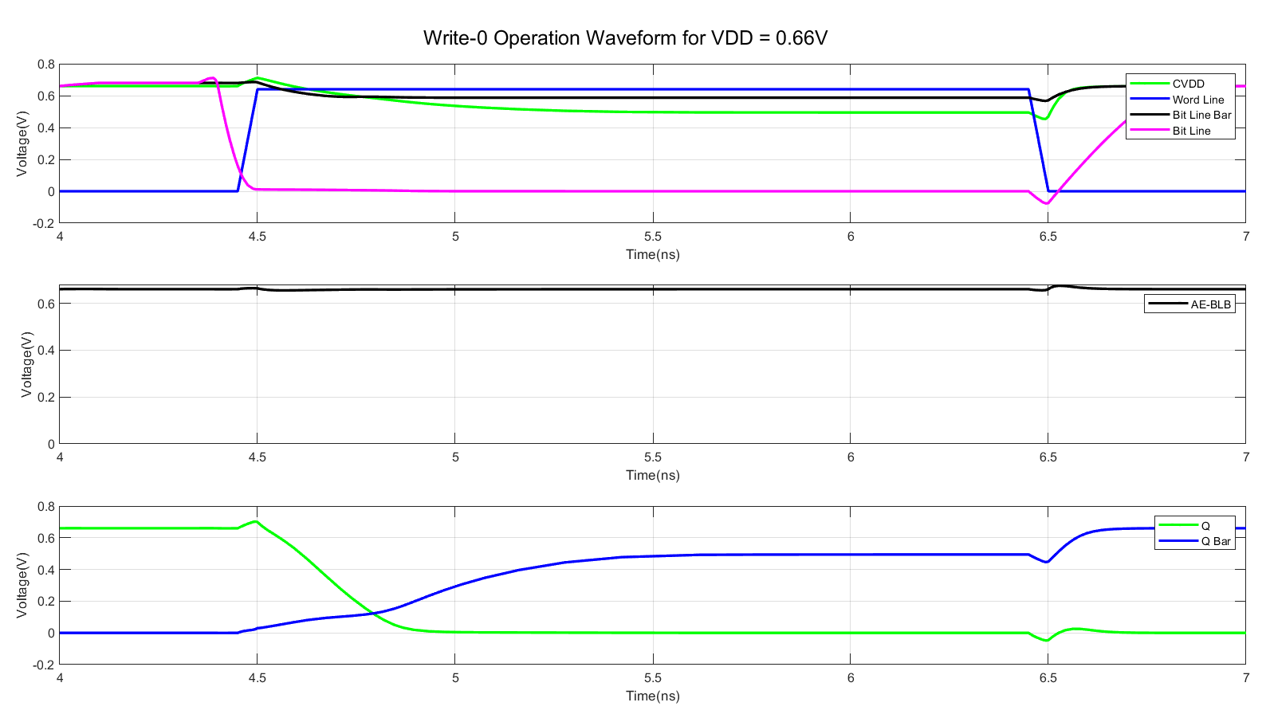
Write-0 Operation Waveform for MEDIUM-σ SC-BCS cell

Slide 24
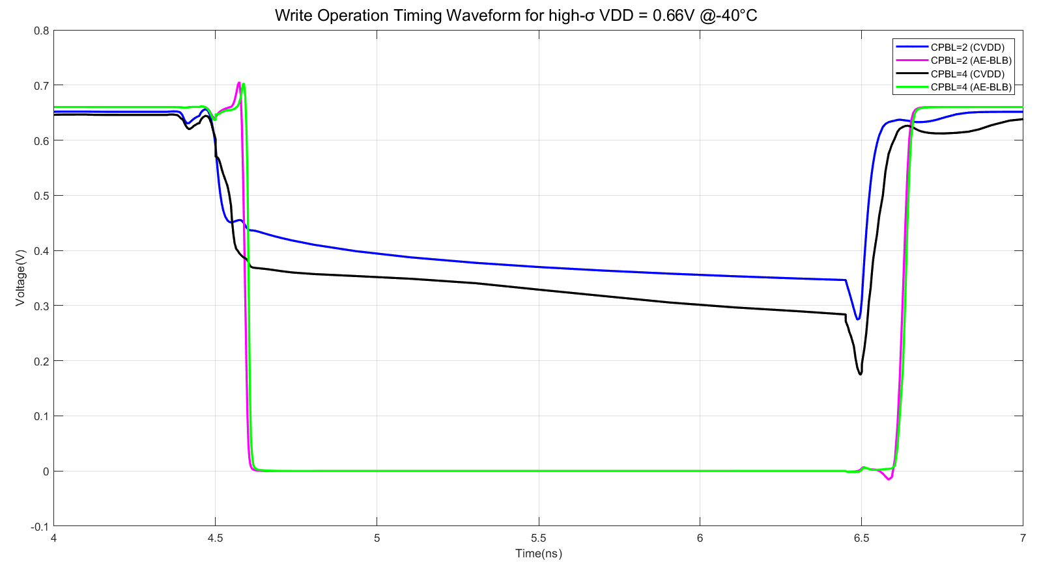
Write operation timing waveform in High-σ SC-BCS cell according to Cell Per Bitline (CPBL)

Slide 25
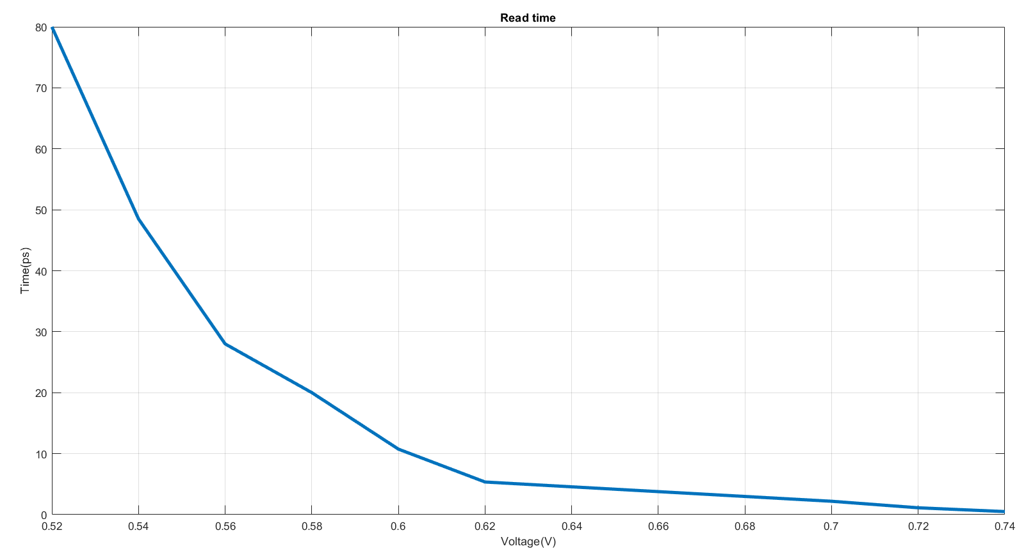
Read Time in High-σ SC-BCS cell

Slide 26
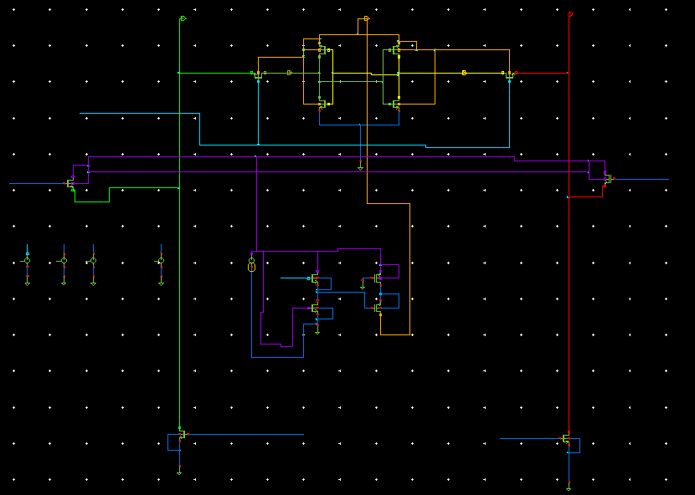
Schematic of GSC SRAM cell

Slide 27
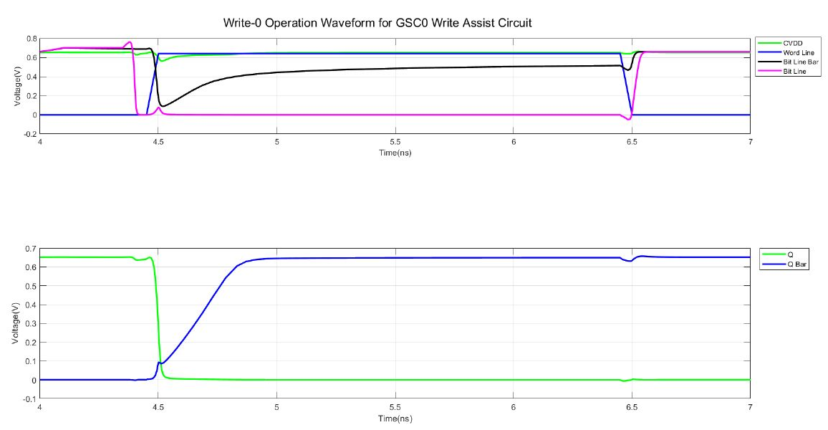
Write-0 Operation Waveform for GSC0 cell

Slide 28
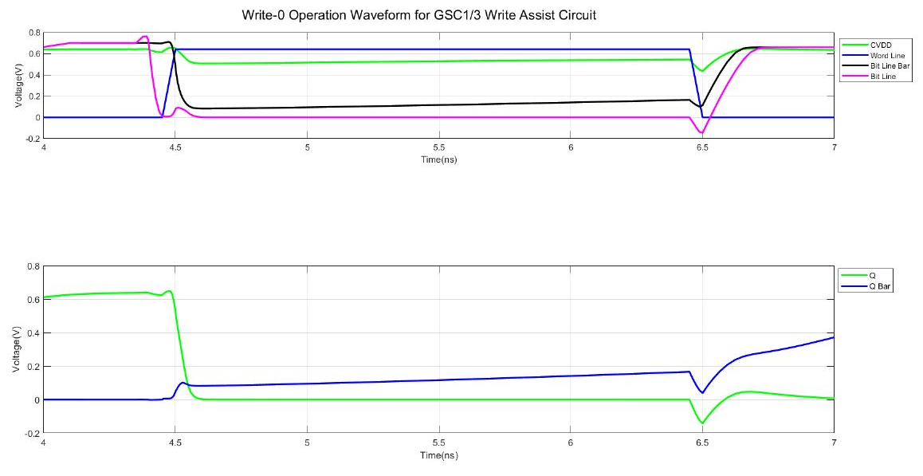
Write-0 Operation Waveform for GSC1/3 cell

Slide 29
Comparison Table for HIGH-σ SC-BCS cell
 | T_{WL} | Write Energy | Q_{L} Delay
V_{DD} = 0.58 V | 2.03 ns | 3.347 pJ | 34.11 ps
V_{DD} = 0.62 V | 1.52 ns | 3.252 pJ | 26.6 ps
V_{DD} = 0.66 V | 1.34 ns | 3.55 pJ | 22.89 ps

Slide 30
Table for Write Energy Comparison
%Age Difference In Write Energy Between SC-BCS And GSC0 | %Age Difference In Write Energy Between SC-BCS And GSC1/3
SC-BCS is 42.27% lower | SC-BCS is 88.4% lower

Slide 31
Sizing of Transistors in SC-BCS circuit using Parametric Analysis
PG_{L} , PG_{R} | 180 nm
PU_{L} , PU_{R} | 160 nm
PD_{L} , PD_{R} | 360 nm
MP_{L} , MP_{R} | 240 nm
MP_{F} | 240 nm
Db, D Transistors in Write Driver | 720 nm
WFSC Nand gate | 3:2 using 45 nm Tech node
WFSC LO-SKEW Not gate | 1:1.5 using 45 nm Tech node
WFSC Pmos_{1,2,3} | 360 nm
WFSC Nmos | 120 nm

Slide 32
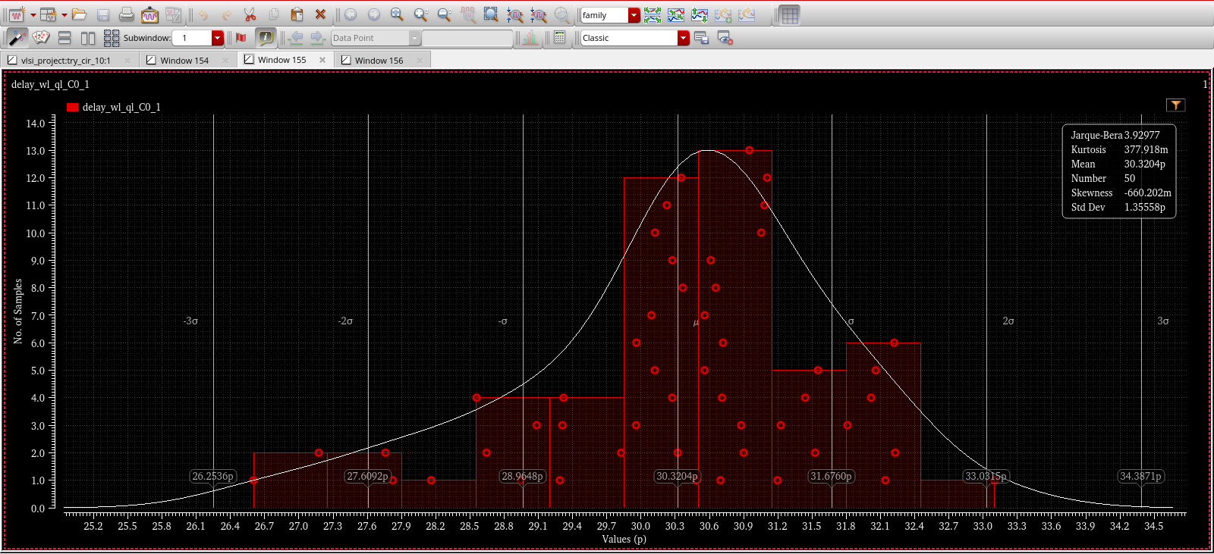
Monte Carlo Simulation for delay at temp(120^{oC}), Vt variations of transistors

Slide 33
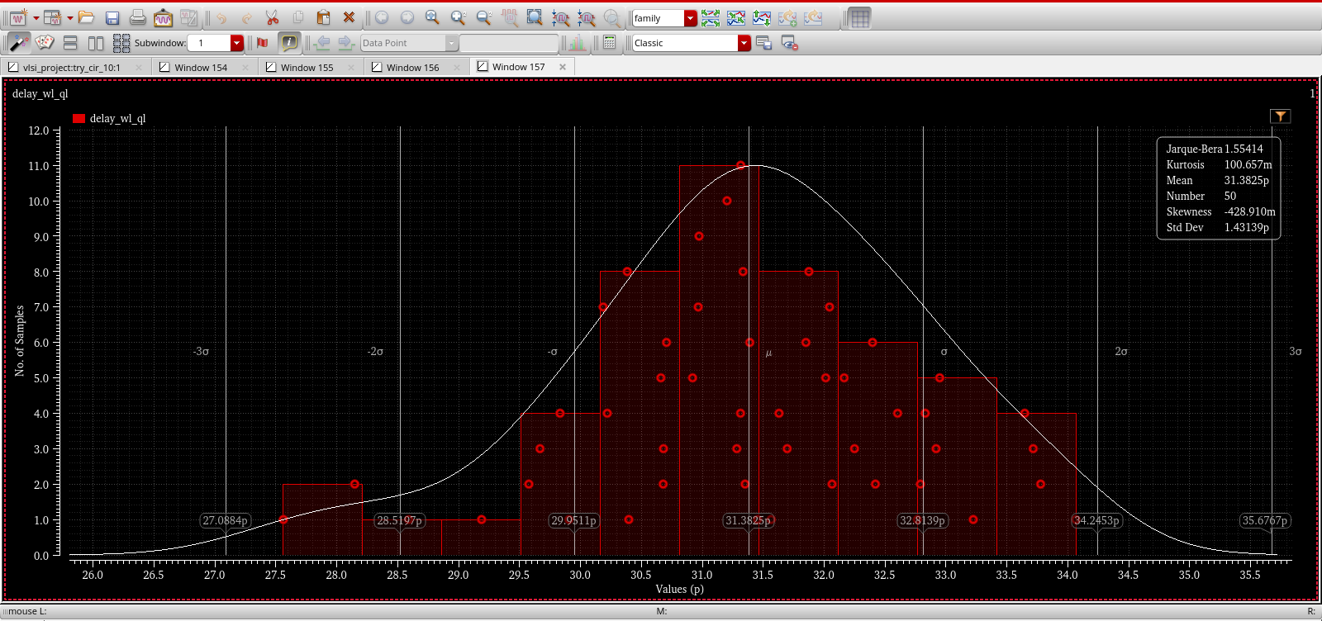
Monte Carlo Simulation for delay at nominal temp, Vt variations of transistors

Slide 34
CONCLUSION
In our simulations, we achieved better T_{WL} as compared to the proposed design in the paper by 2.48 ns or 64.92%.
The overall write energy is 42.27% lower than GSC0 and 88.4% lower than GSC1/3. Hence, the proposed circuit is more energy efficient.

Slide 35
FUTURE WORK
To study and calculate the write ability yield for high and low σ for the write assist circuits.

Slide 36
REFERENCES
https://www.researchgate.net/publication/348448154_Survey_on_Static_Random_Access_Memory#pf3
https://www.eecg.utoronto.ca/~ali/papers/mag-win-15-process-variation.pdf
Z. Guo et al., “A 10nm SRAM design using gate-modulated self-collapse write assist enabling 175mV VMIN reduction with negligible power overhead,” in Proc. Symp. VLSI Circuits, Jun. 2020, pp. 1–2.
E. Karl, Z. Guo, Y.-G. Ng, J. Keane, U. Bhattacharya, and K. Zhang, “The impact of assist-circuit design for 22 nm SRAM and beyond,” in Proc. IEDM, 2012, pp. 25.1.1–24.1.4.
K. Kim, H. Jeong, J. Park, and S.-O. Jung, “Transient cell supply voltage collapse write assist using charge redistribution,” IEEE Trans. Circuits Syst. II, Exp. Briefs, vol. 63, no. 10, pp. 964–968, Oct. 2016.

Slide 37

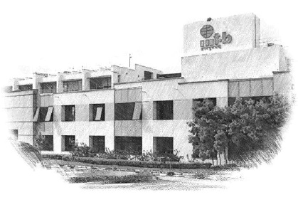






International Institute of Information Technology Bangalore
26/C, Electronics City, Hosur Road,
Bengaluru – 560 100, Karnataka, India
www.iiitb.ac.in
https://www.facebook.com/IIITBofficial/
https://twitter.com/IIITB_official
https://www.linkedin.com/school/iiit-bangalore/
https://www.youtube.com/user/iiitbmedia
https://www.instagram.com/iiitb_official/

